Slide 1
Python embedded in
LibreOffice or OpenOffice documents
Hamilton Python Users Group
Ian Stewart
11-Oct-2021
Repositories:
https://github.com/irsbugs/LO-OO-Macro-Programming
https://github.com/HamPUG/meetings/tree/master/2021/2021-10-11

Slide 2
Python embedded in LO/OO documents
LibreOffice and OpenOffice applications default to allowing BASIC macros to be stored within a Document.
Python macros may also be stored within a document.
Inserting Python macros is made easier using the LibreOffice addon, “Alternative Python Script Organizer”, ASPO APSO.

Slide 3
Previous Presentation on BASIC in LO/OO
WLUG meeting on 23 Aug 2021 presented BASIC in LO/OO.
WLUG repository posting presentation slides and documents...
https://github.com/WLUG/meetings/tree/master/2021/2021-08-23
Documents included are:
  Simple Writer document.
  Draw document simulating piling for a house
  Calc document providing modelling the amortization of a loan.
The presentation was at a virtual meeting that was video recorded. Playback of the video is available at: https://bbb.nzoss.nz/playback/presentation/2.0/playback.html?meetingId=b9e64e4bd74566f13a48d6a5940f3c929982b914-1629703025339

Slide 4
BASIC embedded in LO/OO documents (default)

Slide 5
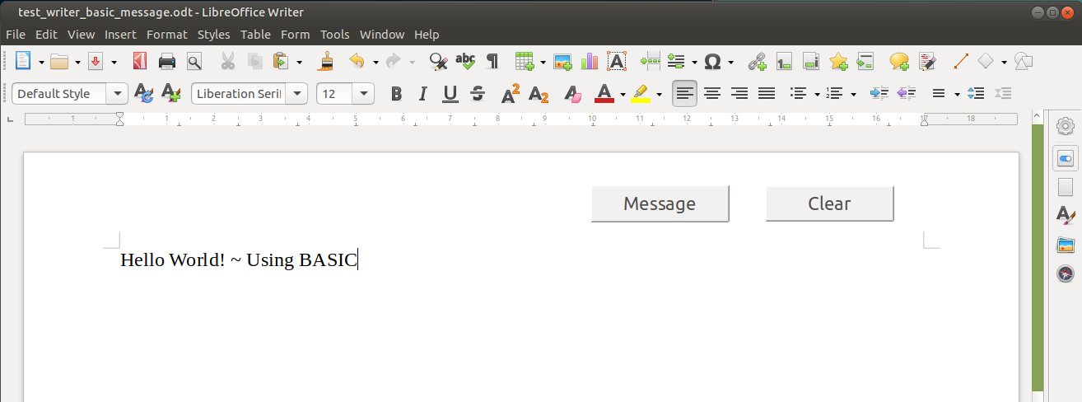
BASIC embedded in LO/OO documents
Writer document with two push buttons that execute BASIC code...

Slide 6
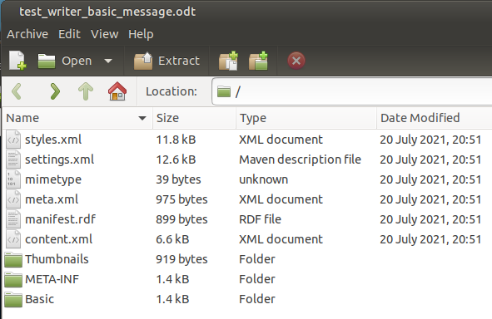
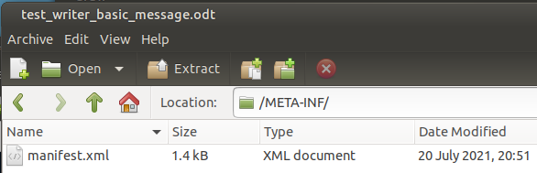
Unzipping of Writer document “test_writer_basic_message.odt”...

Slide 7
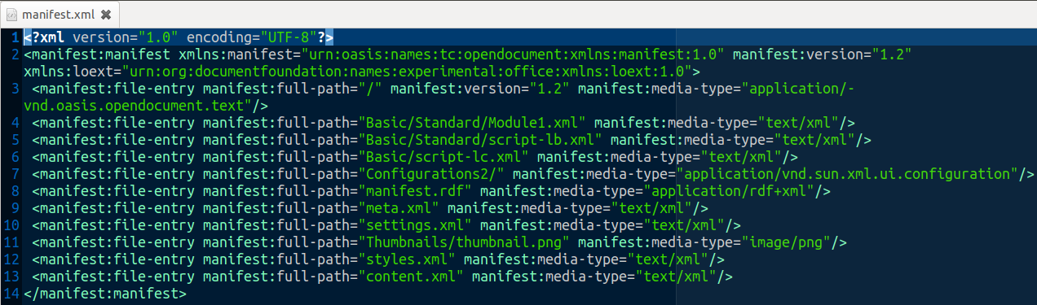

“manifest.xml” lists BASIC scripts are included...

Slide 8
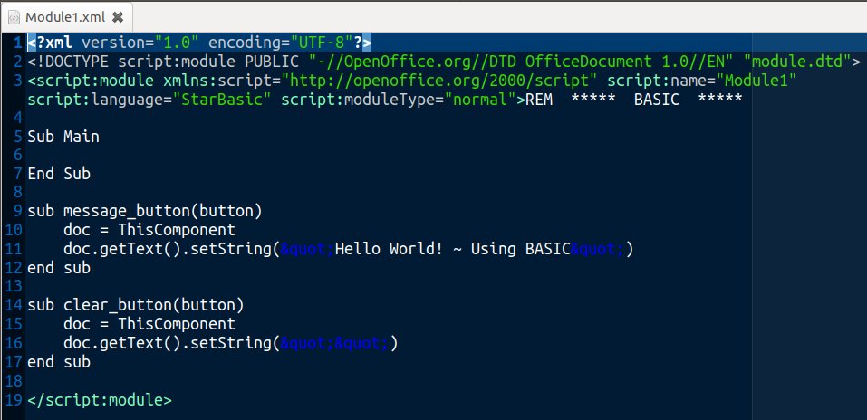
BASIC/Standard/Module1 has the BASIC script for each push button to execute...

Slide 9
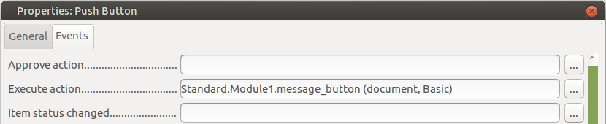
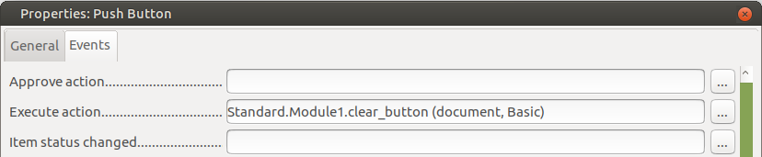
“Execute Action” has description of path to push button BASIC subroutines for “Message” and “Clear”...

Slide 10
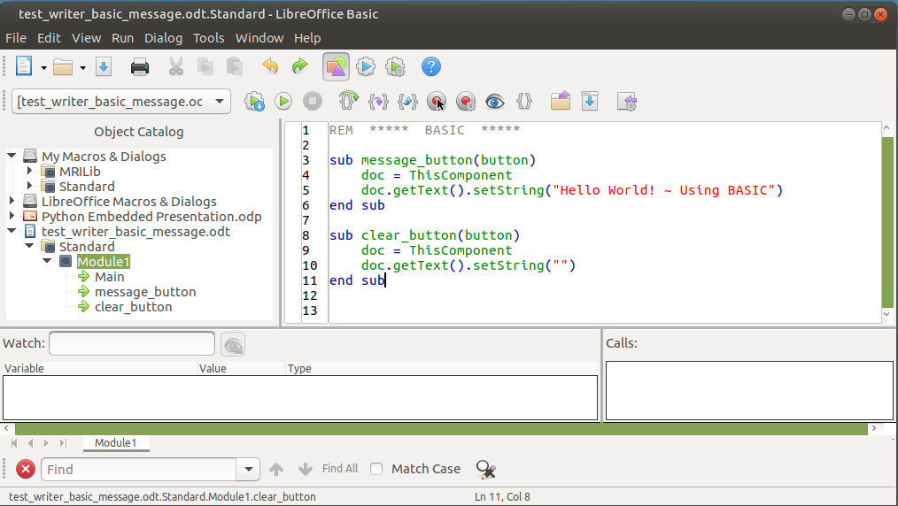
BASIC IDE: Tools --> Macros --> Edit Macros.

Slide 11
Python embedded in LO/OO documents

Slide 12
But first: Python NOT embedded in LO/OO documents
LibreOffice and OpenOffice applications with Python macros can be stored in:
My Macros (In User account space)
ian@leno:~/.config/libreoffice/4/user/Scripts/python$ ls -l
-rw-rw-r-- 1 ian ian 25129 Oct 8 20:58 draw_uno_plan.py
LibreOffice Macros (In System-wide space)
ian@leno:/usr/lib/libreoffice/share/Scripts/python$ ls -l
-rw-r--r-- 1 root root 3384 Oct 8 2020 Capitalise.py
-rw-r--r-- 1 root root 1589 Oct 8 2020 HelloWorld.py
-rw-r--r-- 1 root root 2406 Oct 8 2020 InsertText.py
-rw-r--r-- 1 root root 2090 Oct 8 2020 NamedRanges.py
drwxr-xr-x 2 root root 4096 Apr 23 17:26 pythonSamples
-rw-r--r-- 1 root root 634 Oct 8 2020 SetCellColor.py
Need a PyUno bridge from Python program into LibreOffice:
$ libreoffice --draw --accept="socket,host=localhost,port=2002;urp;StarOffice.ServiceManager"

Slide 13
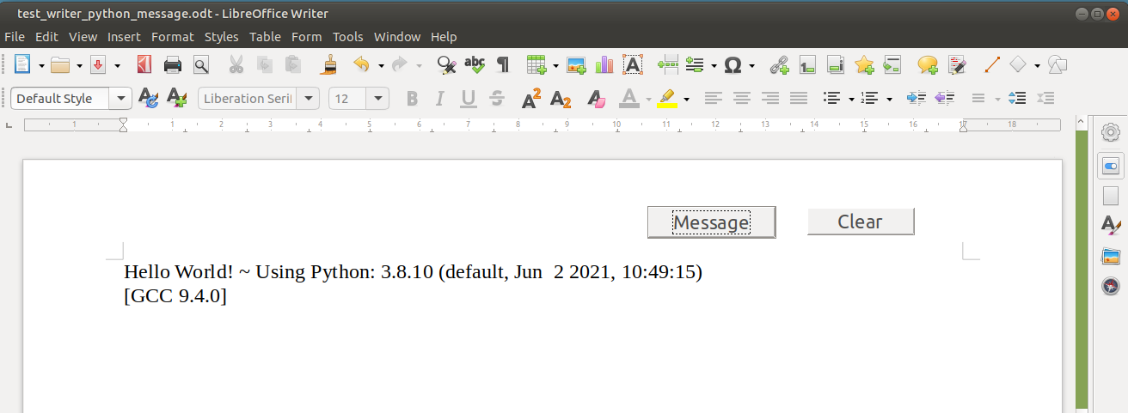
Python embedded in LO/OO documents
LibreOffice and OpenOffice applications with Python macros stored in a Document.

Slide 14
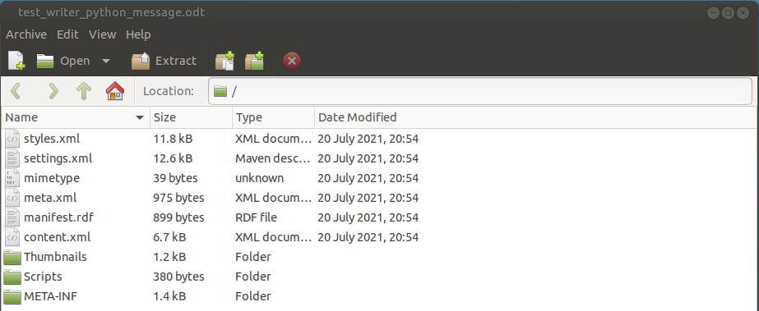
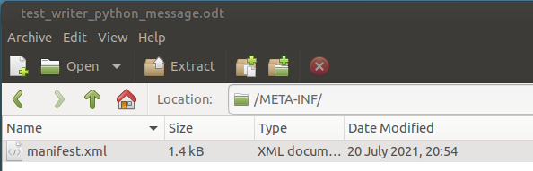
Unzipping of Writer document to view the embedded Python macros

Slide 15
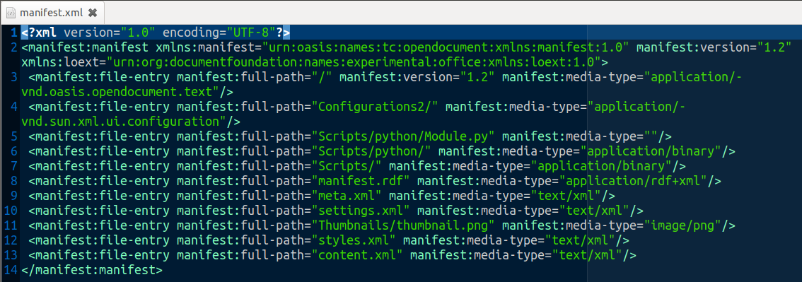

“manifest.xml” file contains references to the Python files.

Slide 16
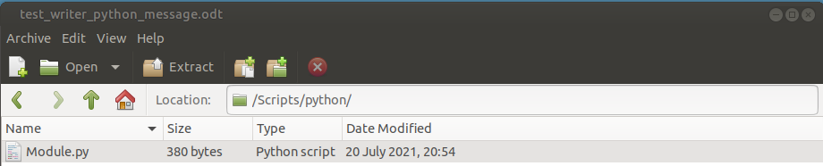
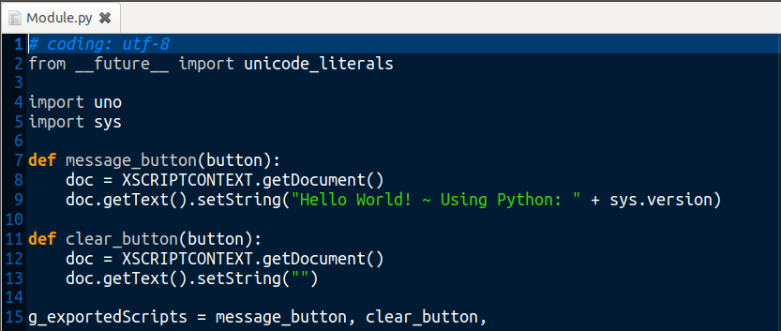
Python script in “Module.py”, in “test_writer_python_message.odt” file...

Slide 17

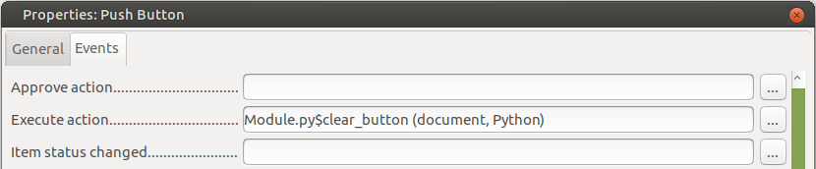
Push button events for “message” and “clear” buttons...

Slide 18
Alternative Python Scripts Organizer (APSO)

Slide 19
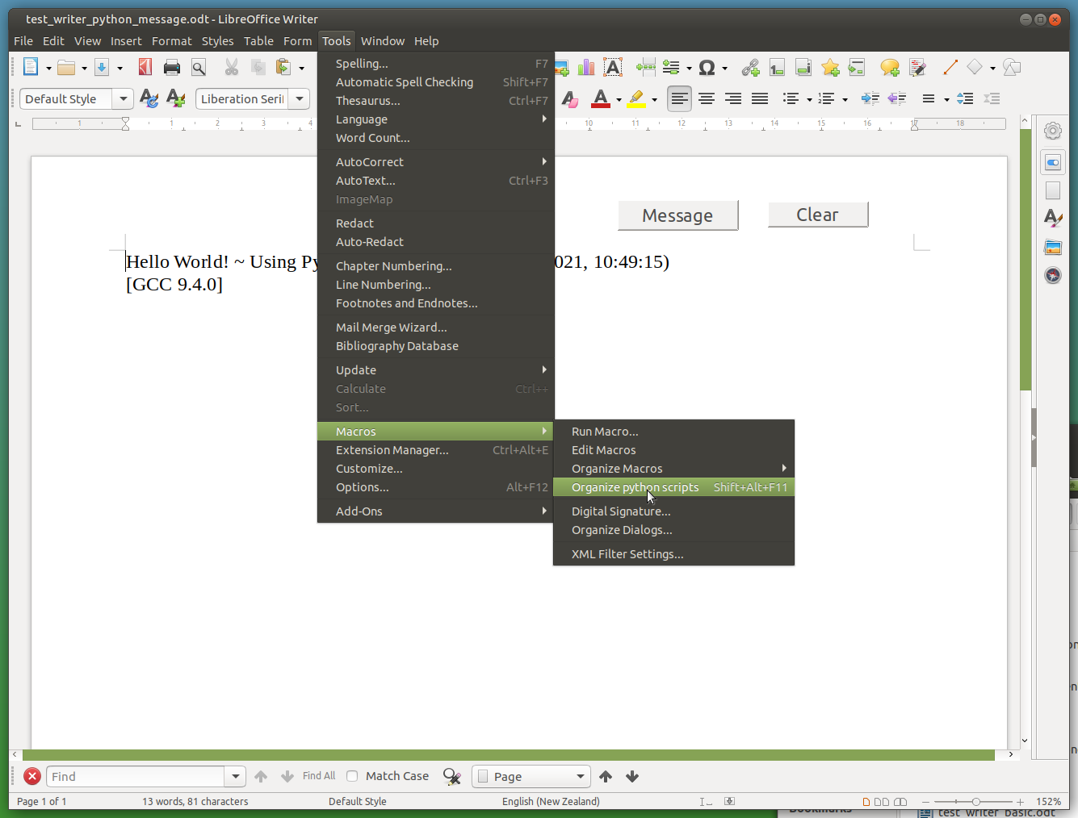
APSO ~
Alternative
Python
Scripts
Organizer

Slide 20
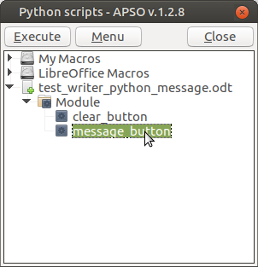
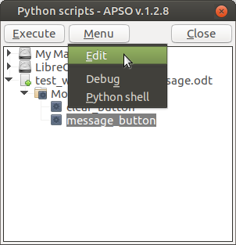
APSO

Slide 21
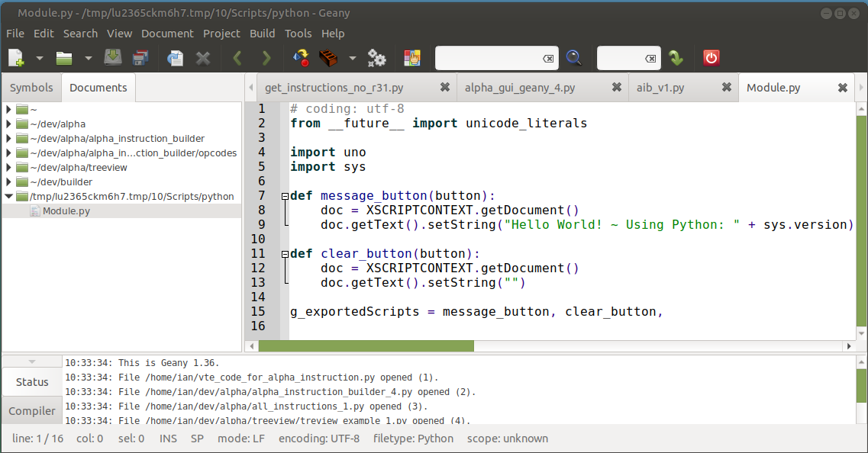
Example of “Geany” as the Python IDE.

Slide 22
APSO ~ Dependency Notes
Advised to install the MRI extension for LibreOffice
Install the default-jre.
$ sudo apt install jre-default
Install libreoffice-script-provider-python
$ sudo apt install libreoffice-script-provider-python

Slide 23
APSO ~ Download and Addon of Extension

Slide 24
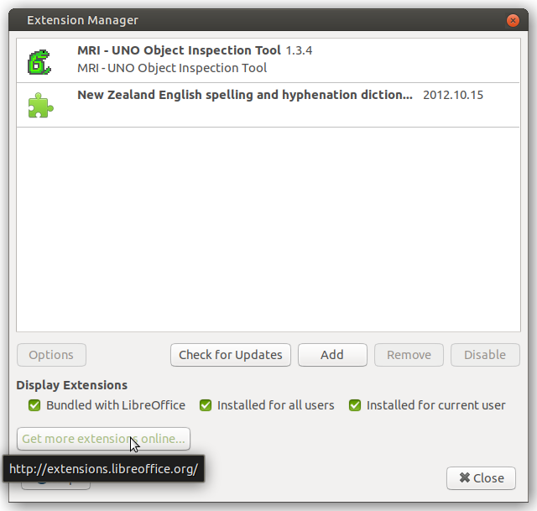
APSO
Performing Addon Extension
for LibreOffice

Slide 25
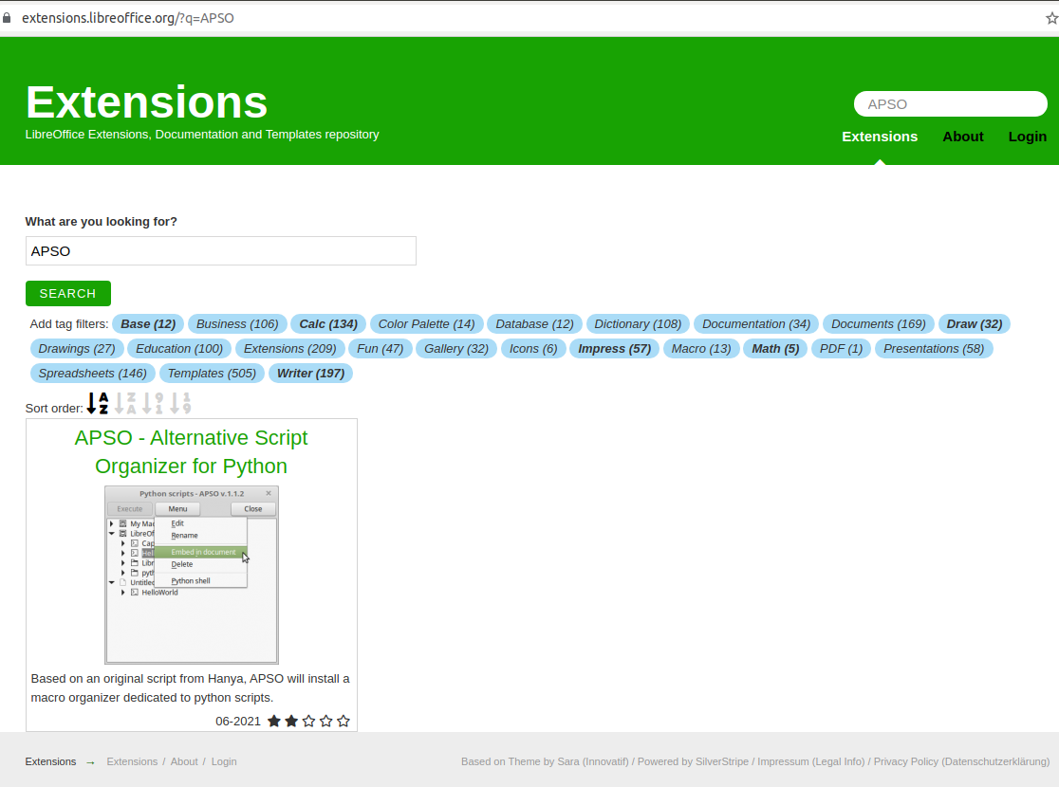
APSO Addon

Slide 26
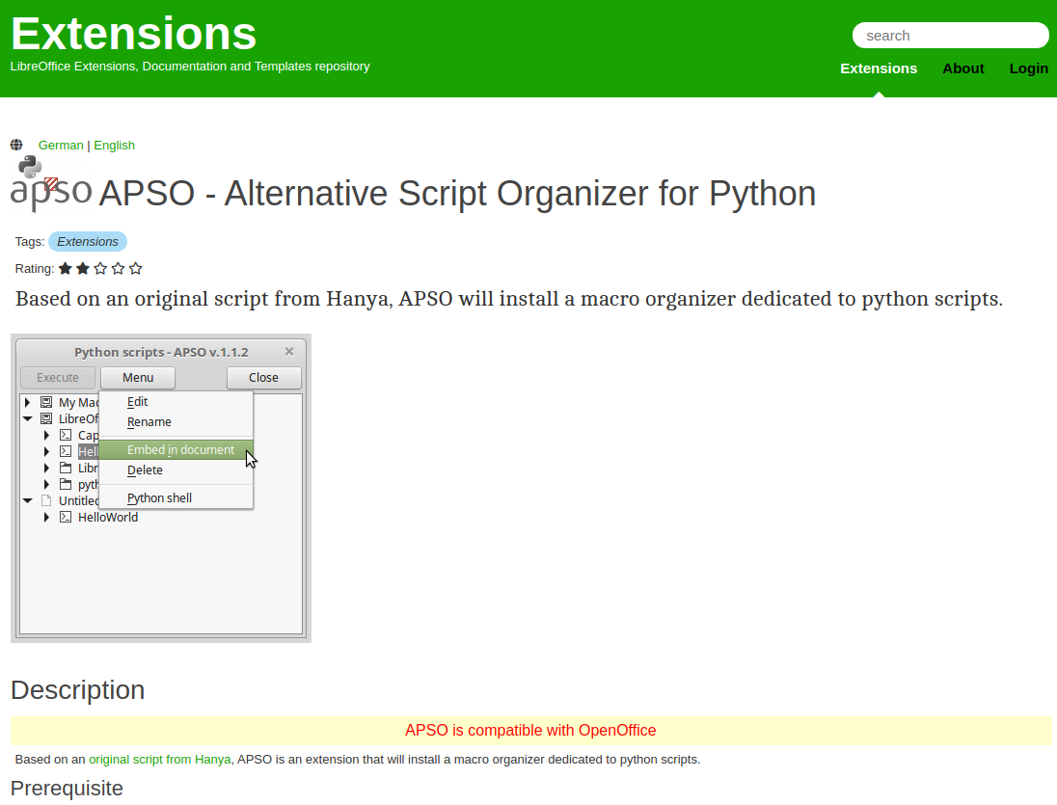
APSO Addon.

Slide 27
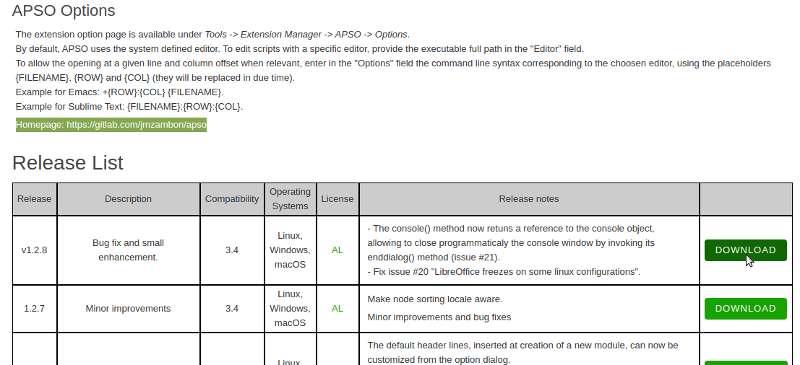
APSO Addon.
Download to Downloads folder...

Slide 28
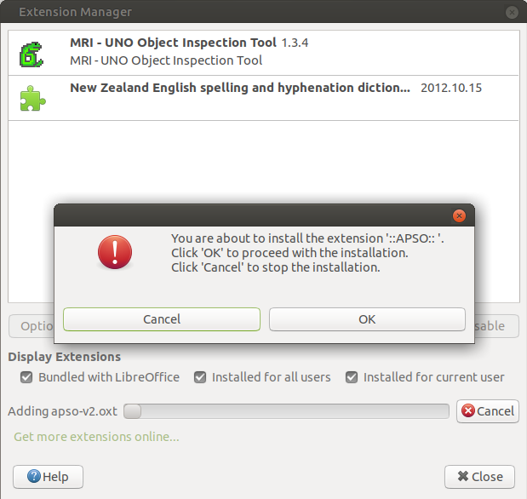
APSO Install addon from
Downloads folder

Slide 29
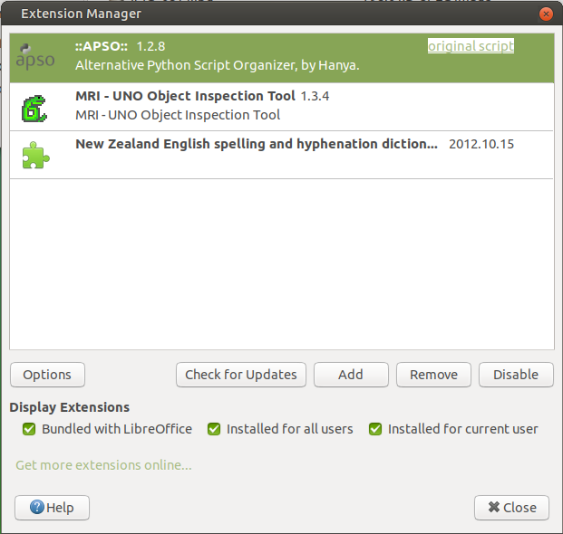
APSO addon installed.

Slide 30
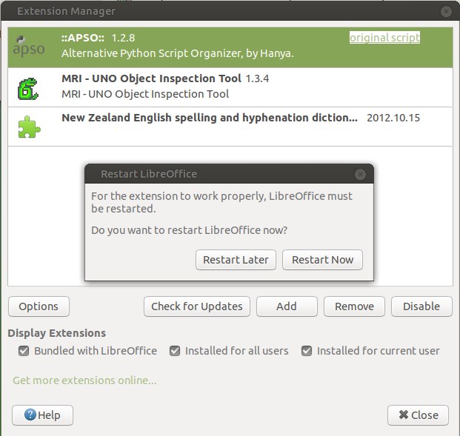
APSO addon installed.

Slide 31
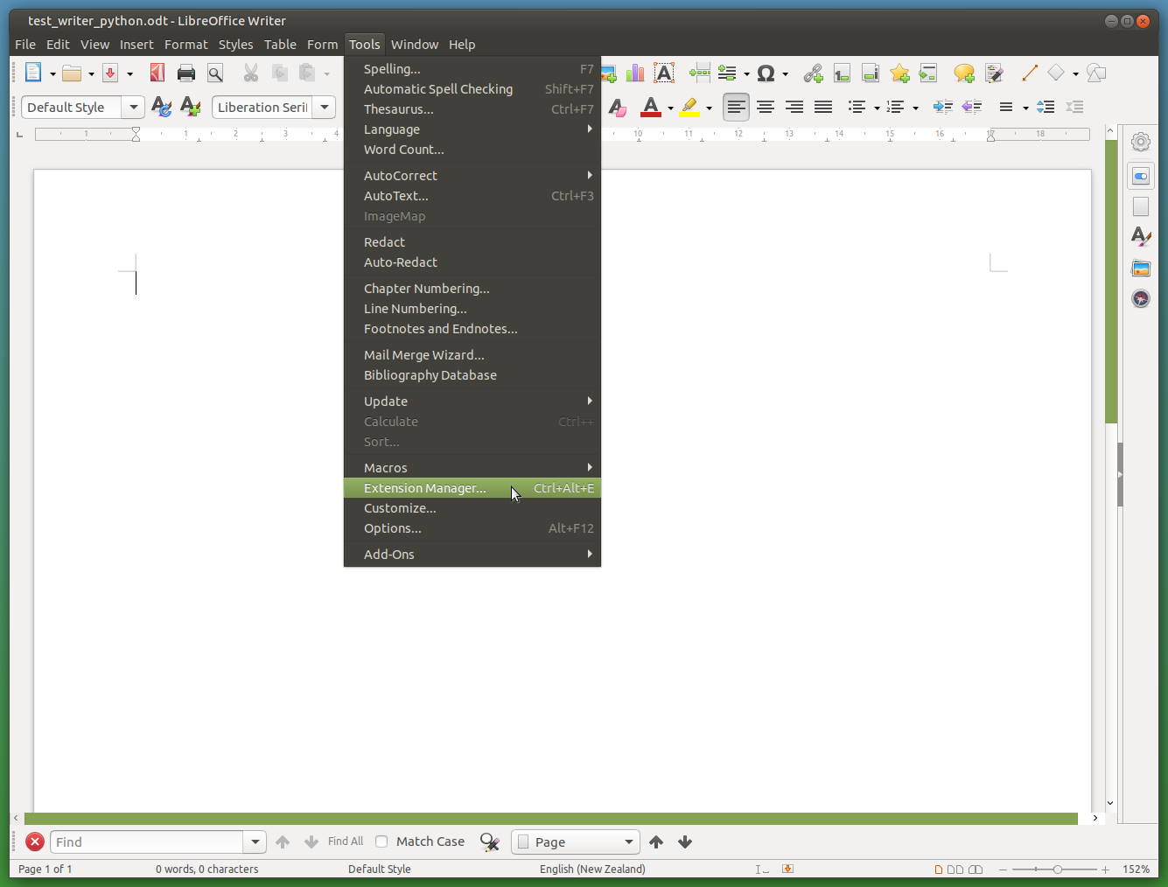
APSO
Tailoring editor.
Tools -->
Extension Manager...

Slide 32
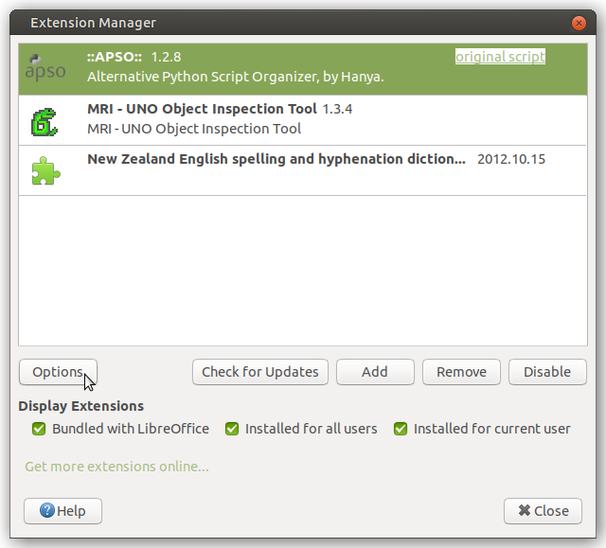
Tools -->
Extension Manager... -->
APSO --> Options

Slide 33
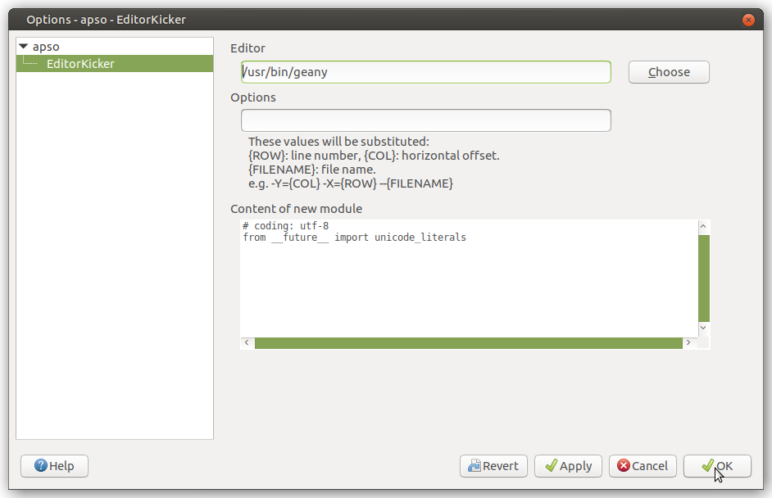
APSO.
Choose
Python
IDE...

Slide 34
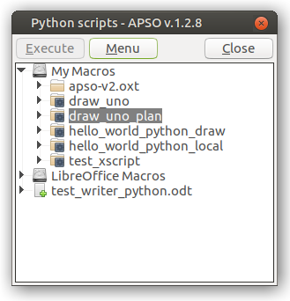
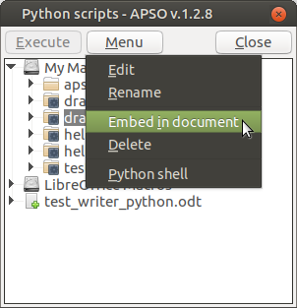
Python Moving from My Macros to Embedded in document.

Slide 35
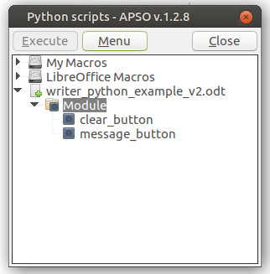
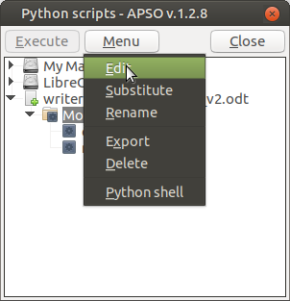
Python Embedded in document. Start Editing.

Slide 36
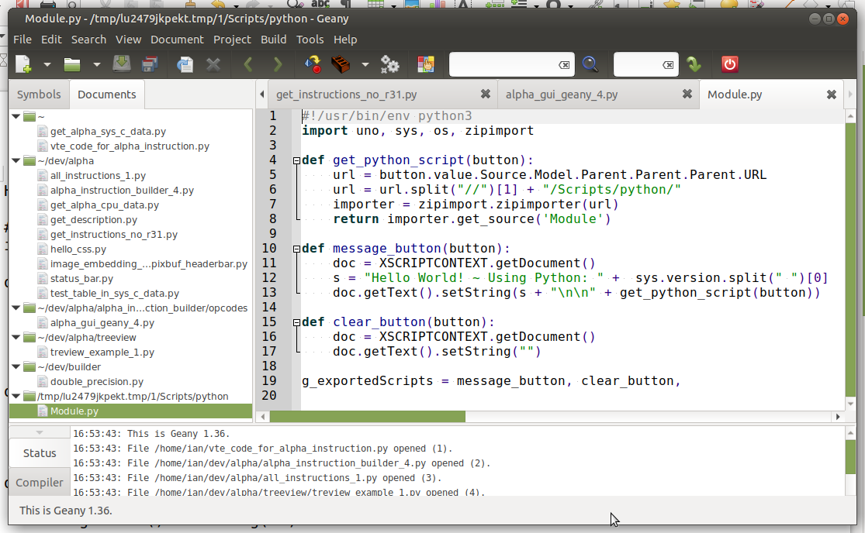
Python Embedded in document. Editing using Geany.

Slide 37
XSCRIPTCONTEXT

Slide 38
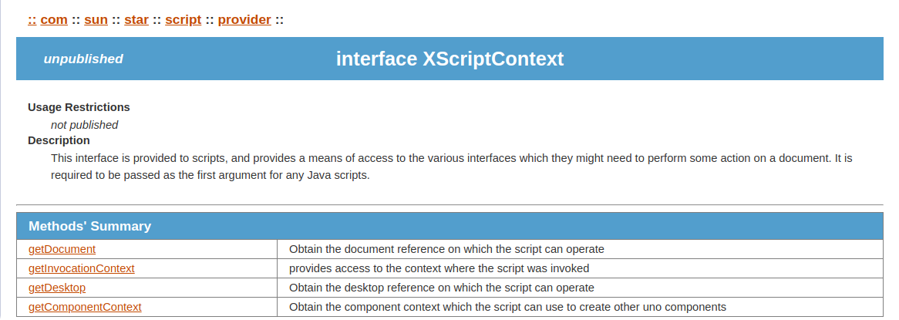
XSCRIPTCONTEXT.
http://www.openoffice.org/api/docs/common/ref/com/sun/star/script/provider/XScriptContext.html

Slide 39
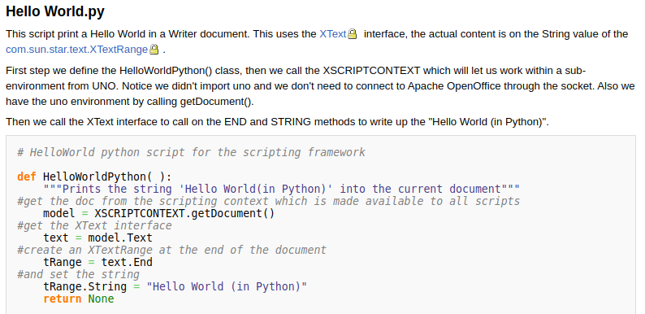
PyUNO Samples
https://wiki.openoffice.org/wiki/PyUNO_samples

Slide 40
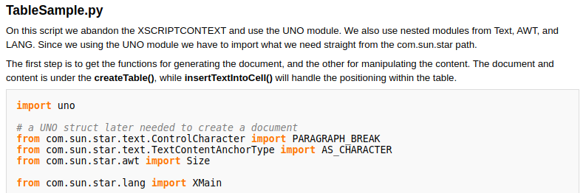
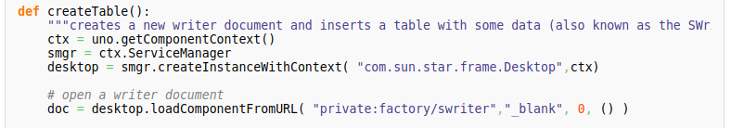
Python code resides in “My Macros & Dialogs”: ~/.config/libreoffice/4/user/Scripts/python/TableSample.py
OR LibreOffice Macros & Dialogs:
/usr/lib/libreoffice/share/Scripts/python/pythonSamples/TableSample.py
Create a socket:
$ libreoffice --writer –accept="socket,host=localhost,port=2002;urp;StarOffice.ServiceManager"
Instead of:
desktop = XSCRIPTCONTEXT.getDesktop()
...more codes... See: https://wiki.openoffice.org/wiki/PyUNO_samples

Slide 41
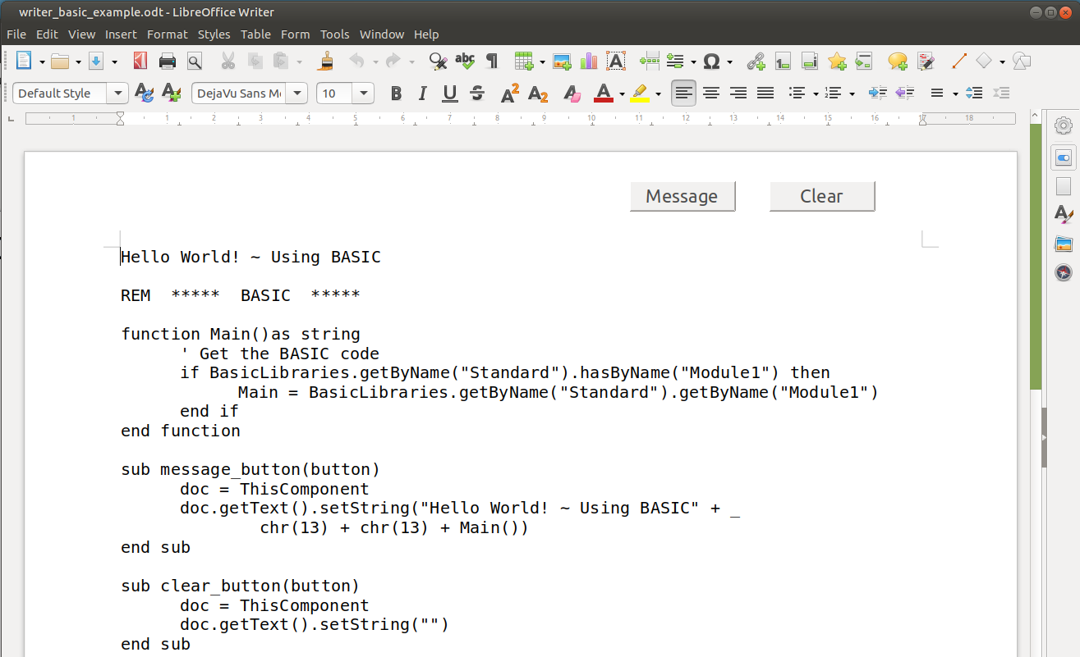
BASIC Sample. Retrieve and Display

Slide 42
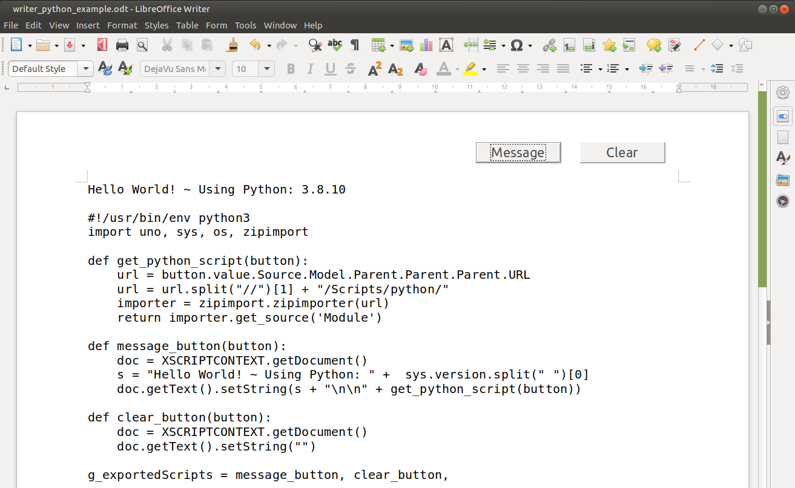
Python Sample. Retrieve and Display

Slide 43
Demo:
Floor Plan ~ Draw document
draw_embedded_python_plan.odg
Amortization ~ Calc document
calc_embedded_python_amortization.ods
APSO Megbox Msgbox
writer_python_msgbox.odt

Slide 44
End.

